Slide 1
Electrical Safety UNIT-V
Review of IE Rules and ACTs and their significance

Slide 2

Ground clearances and Section clearances
Ground clearances
Section clearances
Lightning Discharge Tower (K=1.6)
OHGW (K=1.2)
The distance between the towers (D) is a function of the desired minimum height of the shield net at the middle points between the towers (H0),
where F is a constant that is equal to 7 for lightning discharge tower and 4 for OHGWs.

Slide 3
Protection from Lightning Strikes
Several protection devices that can be used to reroute the energy of the lightning bolt into ground, thus preventing it from reaching important structures or equipment.
Among these devices are lightning poles, lightning discharge towers, overhead ground wires (OHGWs), spark gap, and surge arresters.

Slide 4

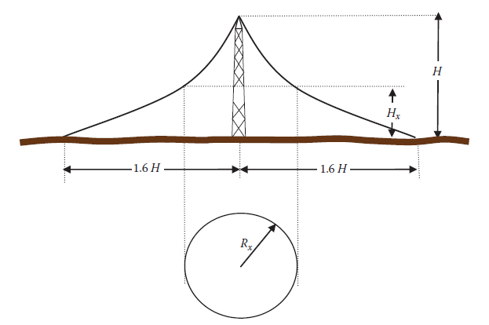
Section clearances: Shield net or Protective zone of lightning discharge tower

Slide 5
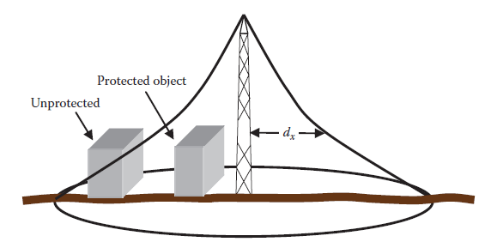
Protective zone of the lightning discharge tower

Slide 6

Problem: maximum lateral distance between the tower
A 30 m tall lightning discharge tower is erected to protect substation equipment. The equipment is 10 m in height and 4 m wide. Compute the maximum lateral distance between the tower and this equipment.
Rx = ?
Since the width of the equipment is 4 m, the inner side of the equipment should not be more than 20 m from the tower.

Slide 7

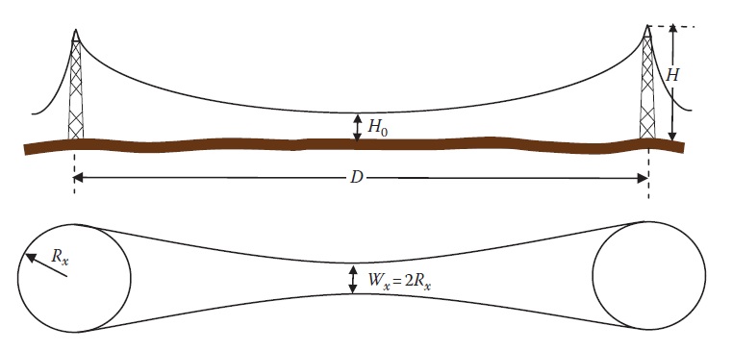
Shield net for two lightning discharge towers

Slide 8


Problem: Computing adequate height for the towers
Two lightning discharge towers of equal heights are separated by 210 m. Compute the height of the towers that protect 10 m cubical equipment at the midline between the towers.
Sol: The height of the tower: D = 7(Ho-H) → H = 40 m.
The width of the protective area is

Slide 9
Overhead Ground Wire
Transmission lines pass through plain areas where the towers and their conductors are the highest conductive objects above ground. These towers are prime targets for lightning strikes; almost 20% of all outages worldwide are attributed to lightning damages.
To protect transmission lines, utilities install OHGWs at the top of the towers and for the length of the transmission lines. These OHGWs are grounded at the substations and at all towers.
Since the OHGWs are the highest grounded objects along the transmission lines, they collect the lightning bolts and disperse them into the ground, thus protecting the transmission line conductors below them from direct lightning strikes.

Slide 10
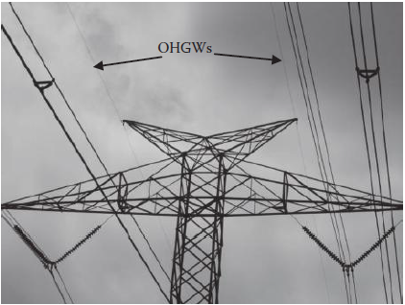
Two OHGWs.

Slide 11
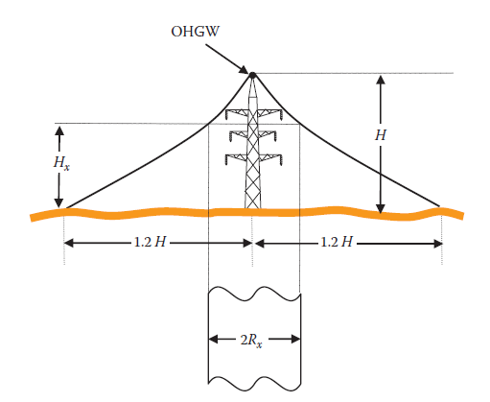
Protective zone of an OHGW

Slide 12
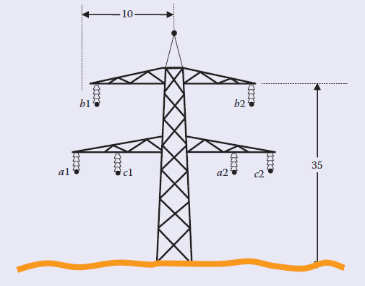
For the transmission line tower shown in Figure, compute the height of a single OHGW wire that protects all phases.

Slide 13

If we protect the top cross arms, all other conductors are also protected
where K = 1.2 for OHGW. For conductor b, Hx = 35 m and Rx = 10 m. Hence,
Solving the previous equation leads to an OHGW’s height of 49.25 m, which would require the OHGW to be about 15 m above the top cross arm.
This is an unrealistic tower size and more than one OHGW is needed.

Slide 14
Electrical Safety Standards
Minimum safe un-energized voltage is 50 Volts without safety tools, during maintenance.
Branch Circuit Sizing: Single phase 120 volts, 15-20 Amps circuit
GFCI - 4-6 mA
AFCI – 30 mA
Branch circuit OCPD (overcurrent protection devices) must have an ampacity of no less than 125% of the continuous loads, plus 100% of the noncontinuous loads.
Conductor sizing

Slide 15
Feeder sizing and Feeder Loads
To protect feeder circuits, you must install overcurrent protection. If a feeder supplies a continuous load, or a combination of continuous and non-continuous loads, then the OCPD cannot be rated any less than the non-continuous load plus 125% of the continuous load amperage.
The ampacity cannot be less than 125% of the full-load current rating plus the calculated load of the electric heat.

Slide 16
The service disconnect limitations
15 A minimum for disconnects to a service for the limited loads of single branch circuits
30 A minimum for disconnects to a service for no more than two two-wire branch circuits
100 A minimum for disconnects to a single-family dwelling service
60 A minimum for all other service disconnect means

Slide 17
Fuses and conductor size limitation standards
All fuses are straight voltage rated, but some circuit breakers are slash voltage rated at 480/277 V, 240/120 V, or 600/347 V
The OCPD cannot exceed the following:
15 A for 14 AWG
20 A for 12 AWG
30 A for 10 AWG
15 A for 12 AWG and 25 A for 10 AWG aluminum and copper-clad aluminum after any correction factors for ambient temperature and number of conductors have been applied

Slide 18
Clearance safety
There must be at least 1 inch of airspace between a cabinet door and any live metal parts, including fuses.
Conductors in an enclosure for switches or overcurrent devices cannot fill the wiring space by more than 40% of the crosssection area inside the enclosure and they cannot fill the cross-sectional area of the space by more than 75%.
Switchboards that are not totally enclosed must have a clearance of 3 feet from the top of the switchboard to a ceiling constructed of wood, drywall, or any other combustible material.

Slide 19
ARC WELDING
Each welder must have overcurrent protection rated no less than 200% of the rated primary current of the welder.
Because of the safety risks from overheating conductors, welding cable has requirements other conductors don’t have.

